Slide 1

Studi kasus Penggunaan Variabel Session

Slide 2
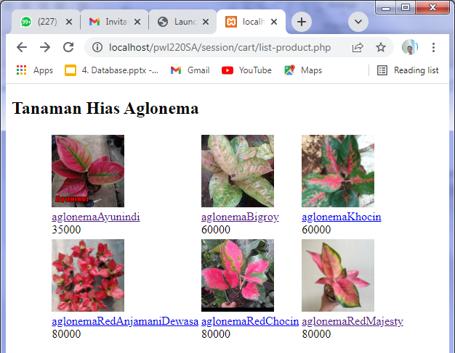
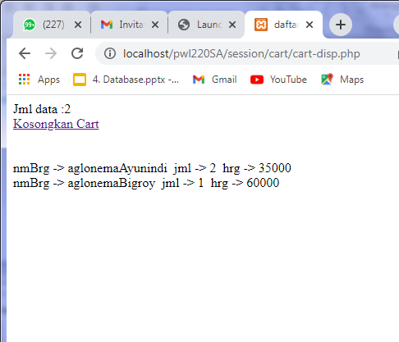
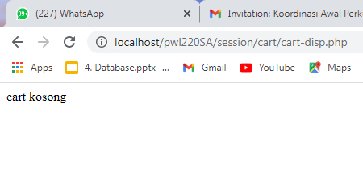
Proses Shopping-Cart menggunakan session-array
Menampilkan Daftar Produk
Memilih produk dan menambahkannya di array Session
Menghapus semua item pada array

Slide 3
$brg=$_GET['brg'];
$hrg=$_GET['hrg'];
$jml=$_GET['jml'];
$item = array('nmBrg'=>$brg, 'jml'=>$jml, 'hrg'=>$hrg);
array_push($_SESSION["cart"]["arrCart"],$item);
header("location:cart-disp.php");
$_SESSION['cart']["arrCart"]=array();
<a href="addCart.php?brg=produk1&hrg=5000&jml=1">produk1</a>
list-product.php
addCart.php
$max=sizeof($_SESSION['cart']['arrCart']);
for ($i=0;$i<$max;$i++){
while (list ($key, $val) = each ($_SESSION['cart']['arrCart'][$i])) {
echo "$key -> $val &nbsp";
}
<a href=cart-remove.php>Kosongkan Cart</a>
session_start();
unset($_SESSION['cart']);
header("location:cart-disp.php");
cart-disp.php
cart-remove.php

Slide 4
Contoh Session Array
(list-product.php)
<?php
session_start();
if (empty($_SESSION['cart']["arrCart"]))
$_SESSION['cart']["arrCart"]=array();
?>
<!DOCTYPE html>
<html>
<body>
<table>
<tr>
<td><a href="addCart.php?brg=produk11&hrg=35000&jml=1">Produk1</a> : 5000 </td>
</tr>
</body>
</html>

Slide 5
(addCart.php)
<?php
session_start();
if ($_SERVER["REQUEST_METHOD"] == "GET") {
$brg=$_GET['brg'];
$hrg=$_GET['hrg'];
$jml=$_GET['jml'];
if (!empty($_SESSION['cart']['arrCart'])){
$max=sizeof($_SESSION['cart']['arrCart']);
$find=false;
for ($i=0;$i<$max;$i++){
$cari=array_search($brg, $_SESSION['cart']['arrCart'][$i]);
if ($cari) {
$_SESSION['cart']['arrCart'][$i]['jml']+=1;
$find=true;
break;
}
}
}
if (!$find){
$item = array('nmBrg'=>$brg, 'jml'=>$jml, 'hrg'=>$hrg);
array_push($_SESSION["cart"]["arrCart"],$item);
}
}
header("location:cart-disp.php");
?>

Slide 6
(cart-disp.php)
<?php
session_start();
?>
<!DOCTYPE html>
<html>
<head>
<title>daftar Isi Cart </title>
</head>
<body>
<?php
if (!empty($_SESSION['cart'])){
echo "Jml data :".sizeof($_SESSION['cart']['arrCart']).
"<br /> <a href=cart-remove.php>Kosongkan Cart</a><br /><br /><br />";
$max=sizeof($_SESSION['cart']['arrCart']);
for ($i=0;$i<$max;$i++){
while (list ($key, $val) = each ($_SESSION['cart']['arrCart'][$i])) {
echo "$key -> $val &nbsp";
}
echo "<br />";
}
}else
echo "cart kosong";
?>
</body>
</html>

Slide 7
(cart-remove.php)
<?php
session_start();
unset($_SESSION['cart']);
header("location:cart-disp.php");
?>
E:\xampp\htdocs\pwl220SA\session\cart.zip

Slide 8
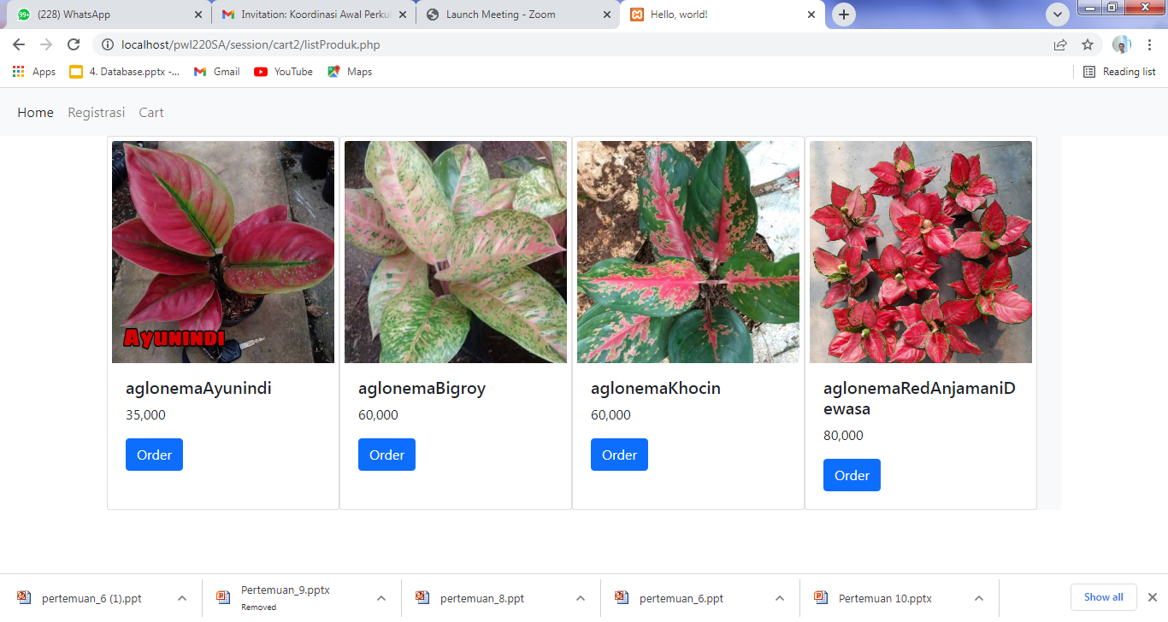
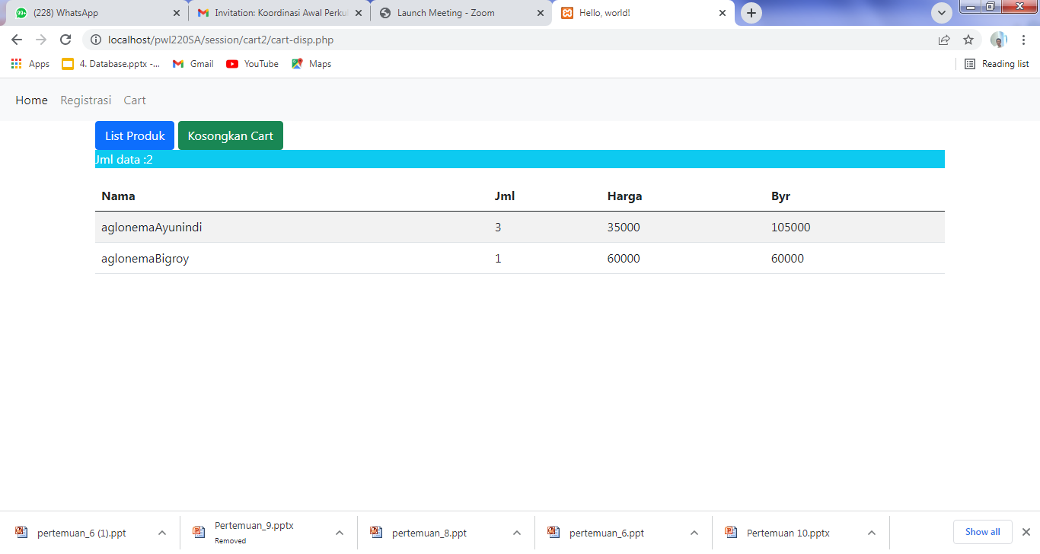
Latihan
Perbaiki tampilan programcontoh di atas menggunakan bootstrap :

